Slide 1
Gametogenesis
Spermatogenesis
Dr. Samer Alnussairi

Slide 2
Objectives
Spermatogenesis.
Spermiogenesis.
Hormonal effect on spermatogenesis.
Abnormalities in gametes development.

Slide 3
Gametogenesis
Is the process of formation of gametes from germ cells in the testes and ovaries.

Slide 4
Spermatogenesis
It’s a complex series of changes, begins at puberty by which spermatogonia are transferred into spermatozoa.

Slide 5
Spermatogenesis
In male, gametogenesis continues into advanced age. Primordial germ cells (46,2N) migrate into the developing testis at week 4.
At puberty these cells differentiate into type A spermatogonia (46,2N). They divide by mitosis to form either more type A spermatogonia or type B spermatogonia.

Slide 6
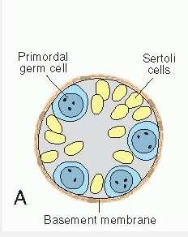
In the male infant
Germ cells can be recognized in the sex cords of the testis as large, pale cells surrounded by supporting cells.
Supporting cells become Sustentacular cells or Sertoli cells.

Slide 7
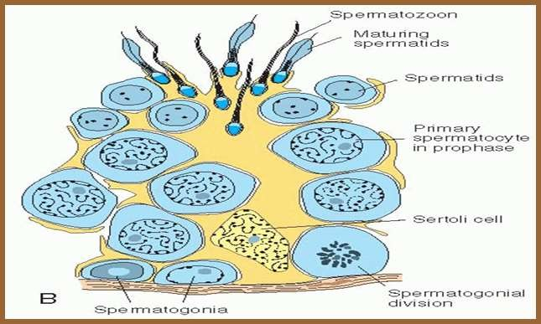
Shortly before puberty
The sex cords acquire a lumen and become the seminiferous tubules.
Maturation of Sperm begins at Puberty.
At about the same time, primordial germ cells give rise to spermatogonial stem cells.

Slide 8
Spermatogenesis
It’s can be divided into three phases:
Spermatocytosis
Meiosis
Spermiogenesis

Slide 9
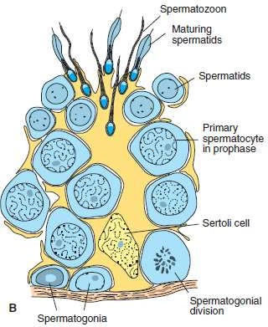
Spermatocytosis
Spermatogonia proliferate by mitotic division to replace themselves and to produce primary spermatocytes.

Slide 10
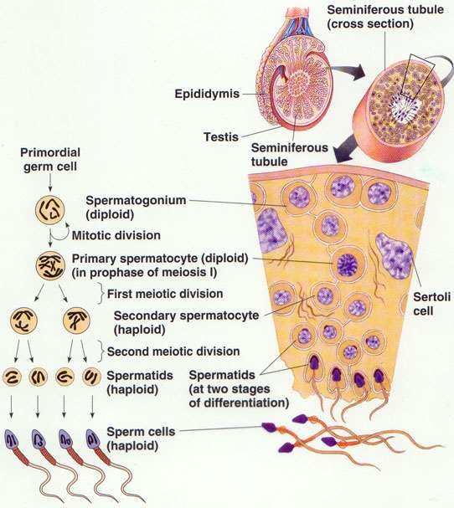
Meiosis
Two successive divisions:
Meiosis I produce secondary spermatocytes.
Meiosis II produce
spermatids.

Slide 11
Spermiogenesis
The series of changes resulting in the Transformation of spermatids into spermatozoa include:
Formation of the acrosome, which covers half of the nuclear surface and contains enzymes to assist in penetration of the egg during fertilization;
Condensation of the nucleus;
Formation of neck, middle piece, and tail;
Shedding of most of the cytoplasm.

Slide 12
Regulation of Spermatogenesis
Spermatogenesis is regulated by LH( leutilizing hormone), that binds to receptors on Leydig cells (interstitial) & stimulates the production of testosterone.
FSH ( follicular stimulating hormone) is also essential, it binds to sertoli cells and stimulates production of testicular fluid and synthesis of intracellular androgen receptors proteins.

Slide 13
Abnormal Male Gametes
Morphological Abnormalities: up to10% have observable defects.
The head & tail may be abnormal, they may be:
giants.
Dwarfs.
Joined in head or in tail.
Lack motility and don’t fertilize the egg.

Slide 14
Abnormal Male Gametes
2. Numerical Abnormalities:
Oligospermia: Few number of sperms in semen.
Aspermia: No sperms at all in semen.
Necrospermia: Sperms found dead.

Slide 15
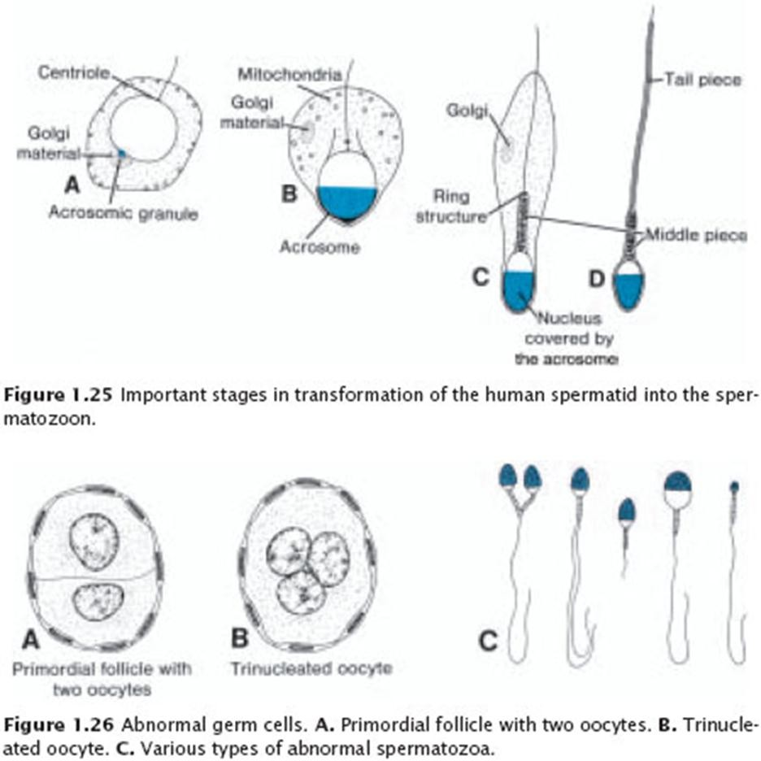
Abnormal Female Gametes
- Primordial follicle with two oocytes these oocytes may give rise to twins & may degenerate before reaching maturity.
- In rare case, one primary oocyte contains two even three nuclei such binucleated or trinucleated oocytes die before reaching maturity.

